Slide 1
CSC141 Introduction to Computer Programming
Teacher:
AHMED MUMTAZ MUSTEHSAN
Lecture - 3

Slide 2
Problem Solving and Implementation A programming task can be divided into two phases: 1. Problem solving Define : Clearly describe a problem Design its solution: Produce an ordered sequence of steps that describe solution to the problem; 2. Implementation phase Implement the program in some programming language write code, compile, link, Test & Debug

Slide 3
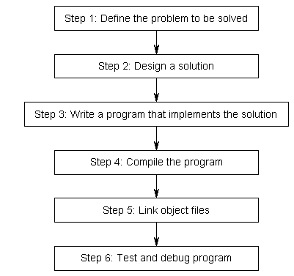
Developing a program
Problem solving
Phase
Implementation phase

Slide 4
Defining a Problem: Break the definition of the problem down into manageable steps. Example; input, Processing; Output
Input ; Read the temperature from keyboard
Processing; Test the Temperature below or above freezing
Output; Display the result on Screen
Users: Identify the users.
Feasibility & Implementation.

Slide 5
Design the solution
Algorithm
A sequence of language independent steps which may be followed to solve a problem. An Algorithm can be developed with a:
Pseudo Code
Flowchart
Preferably using control Structures.

Slide 6
Algorithm
Pseudo code
Pseudo code is a method of designing a program using English like statement to describe the logic and processing flow.
There are no real rules; organizations follow their own standards. Conveniently understood and exchanged between IT professionals.

Slide 7
Defining a Problem: Break the definition of the problem down into manageable steps; Input, Processing; Output
Example -1:
Read in the temperature. If the temperature is less than 32 indicate below freezing on the screen. Else if the temperature is above freezing then indicate the same on the monitor screen.
Divide the above problem into manageable parts.
Input ; Read the temperature from keyboard
Processing; Test the Temperature below or above freezing
Output; Display the result on Screen

Slide 8
Algorithm
Pseudo code
Example -1:
Read the Temp
if (Temp < 32) then
Print “BELOW FREEZING”
else
Print “ABOVE FREEZING”
endif

Slide 9
Algorithm
Flowchart
Diagrammatic or Graphical representations of steps for solving the given problem.
Use standard symbols developed by ANSI (American National Standard Institute)

Slide 10
Building Blocks of Flowchart
Start and End Symbols
Connector
Arrows (indicate flow of control)
Processing Steps
Input/Output
Decision

Slide 11
Defining a Problem: Break the definition of the problem down into manageable steps; Input, Processing; Output
Example -1:
Read in the temperature. If the temperature is less than 32 indicate below freezing on the screen. Else if the temperature is above freezing then indicate the same on the monitor screen.
Divide the above problem into manageable parts.
Input ; Read the temperature from keyboard
Processing; Test the Temperature below or above freezing
Output; Display the result on Screen

Slide 12
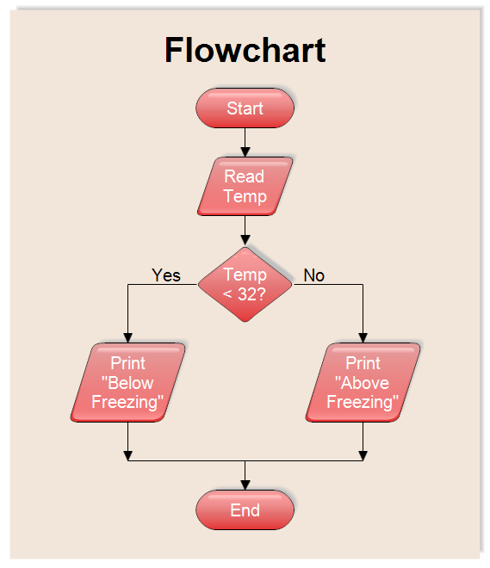

Slide 13
Define The Problem Example-2; Determine the sum of first 50 natural numbers. Break into steps Input – Nil Processing: Sum the numbers from 1 to 50 Output - Sum

Slide 14
Design the Solution Example-2; Determine the sum of first 50 natural numbers. Algorithm; Pseudo Code 1. Set N=1 Set Sum = 0 2. Repeat step 3 & 4 while N <= 50 3. Sum = Sum + N 4. N = N + 1 5. Print Sum 6. end

Slide 15
Design the Solution Example-2; Determine the sum of first 50 natural numbers. Algorithm; Flow Chart
Start
Sum=0
N=1
N≤50
N
Sum=Sum+N
N=N+1
Y
Print Sum
End

Slide 16
Example-3: Determine the factorial of input number

Slide 17
Define The Problem Example-3; Determine the factorial of input number. Break into steps Input – Number is N Processing: Factorial = N x N-1 x N-2 x N-3 ……. 3 x 2 x 1 Output - Factorial

Slide 18
Design the Solution Example-3; Determine the factorial of an input number. (assume number is positive) Algorithm; Pseudo Code 1. Set Factorial = 1 2. Read N from keyboard 3. if ( N = 0 ) goto step 6 4. Factorial = Factorial x N 5. N = N – 1 ; goto step 3 6. Print Factorial 5. end

Slide 19
Design the Solution Determine the factorial of an input number. Algorithm; Flowchart
Start
Read N
Fact =1
Y
N = 0
N
Print Fact
Fact =Fact *N
End
N=N-1

Slide 20
Control Structure:
Definition;
A control structure or logic structure is a structure that controls the logical sequence in which the instructions are executed. Three types of control structure are used:
Sequence
Selection
Iteration ( or loop)

Slide 21
Developing a program
Problem solving
Phase
Implementation phase

Slide 22
Implementation Phase
Write a program (source code)
Compile a program (source code to Object code)
Link a Program ( Object code to Executable code)
Test and Debug the Program (rectify the errors in the program)

Slide 23
Write a code
Create a source code we need an editor
Line editor --- line by line editing
Screen editor --- note pad, word pad, customized editor
After writing the code we save the code with file extension
e.g .c .cpp

Slide 24
Compile a program
source code to Object code
We need a compiler e.g FORTRAN, PASCAL or C
It converts user readable code to machine readable code
Cannot be executed because different sections are not mapped together, say not linked together

Slide 25
Link a Program
Object code to executable code
first.obj to first.exe
Can be executed because different sections are mapped together.
Execute the code by simply typing the name of file
first.exe or even first

Slide 26
Test and Debug the program
Rectifying logical errors in the code, manually or may Use debugger for the assistance. A debugger may:
Execute the code line by line or block by block or in one go
Examine the contents of variables and registers at each step
Examining the flow of control structure by tracing code step by step.

Slide 27
Two ways: 1. Use command prompt e.g DOS or UNIX command prompt 2. Use Integrated Development Environment
Program Execution

Slide 28
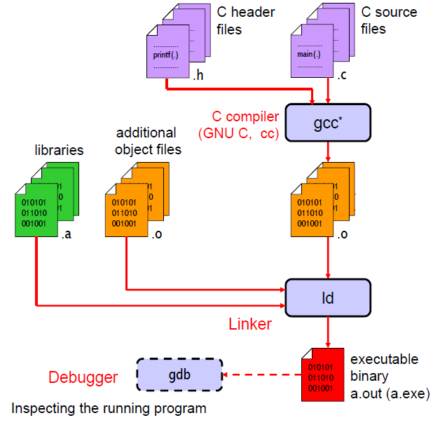
Command prompt

Slide 29
1. A source code editor 2. A compiler and / or an interpreter 3. Build automation tools 4. A Debugger
Integrated Development Environment (IDE)
Compiler – translates complete code in one go
Interpreter –translates code one line at a time

Slide 30
Typical C environment
Editor
Program is created in
the editor and stored
on disk.
Disk
Preprocessor
Disk
Preprocessor program
processes the code.
Compiler creates
object code and stores
it on disk.
Compiler
Disk
Linker
Disk
Linker link the libraries with object code performs address calculations map the variables and produces the .exe file
Primary
Memory
Loader
Loader puts program
in memory.
Disk
.
.
.
.
.
.
Primary
Memory
CPU
CPU takes each
instruction and
executes it, and
store new data
values as the program
executes.
.
.
.
.
.
.

